Slide 1
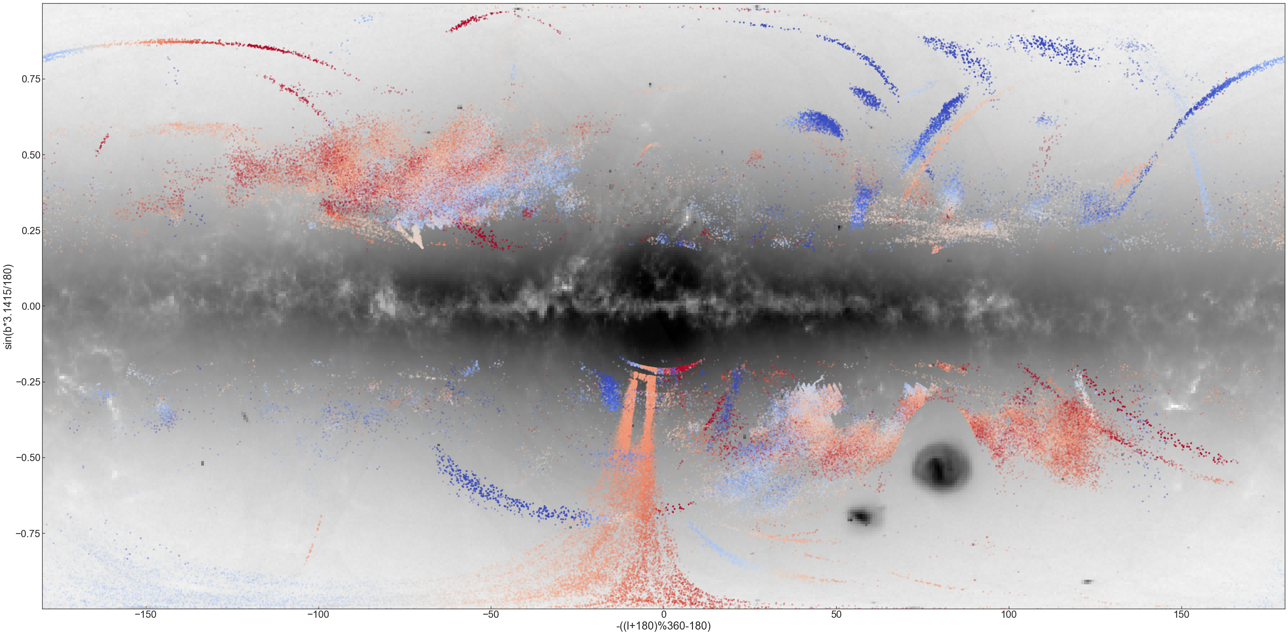

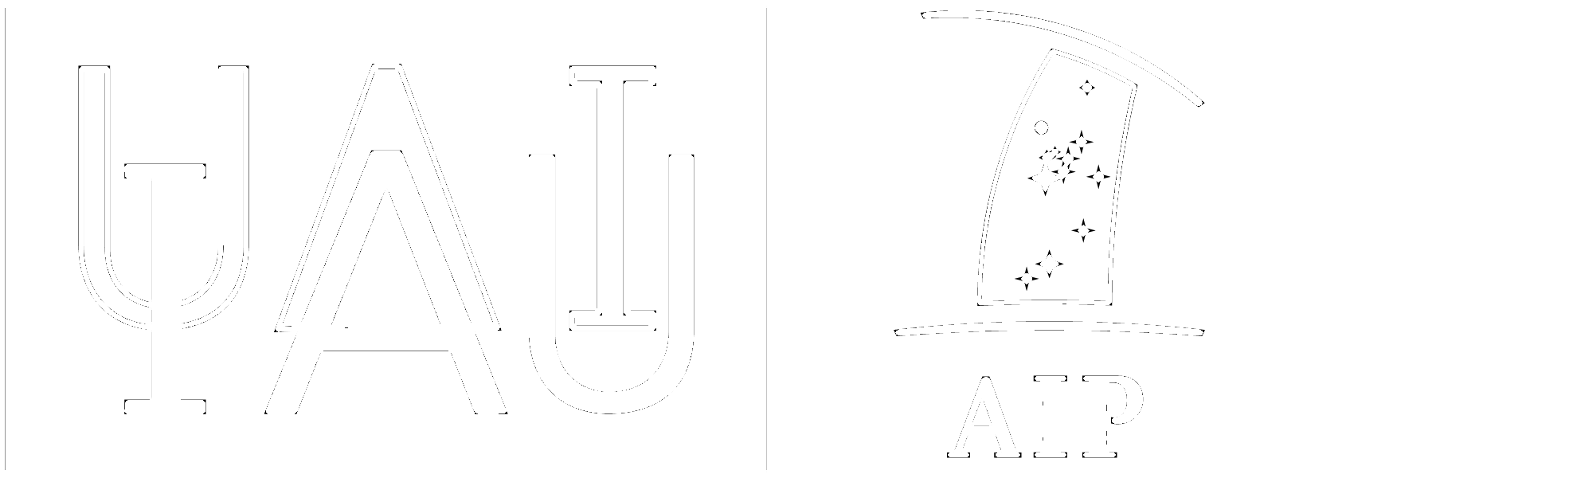
Detection of density variations and off-track features in stellar streams
Akshara Viswanathan
with Else Starkenburg, Helmer Koppelman, Amina Helmi, Eduardo Balbinot, Anna F. Esselink (Kapteyn)
Background: Adapted from STREAMFINDER data
Viswanathan+23, arXiv:2302.00053
viswanathan@astro.rug.nl

Slide 2
OVERVIEW
01
02
03
04
RPM halo SAMPLE
Caveats of the sample
STREAMS – GD-1, Jhelum, Phlegethon
GAPS, KINKS, DENSITY VARIATIONS
viswanathan@astro.rug.nl

Slide 3
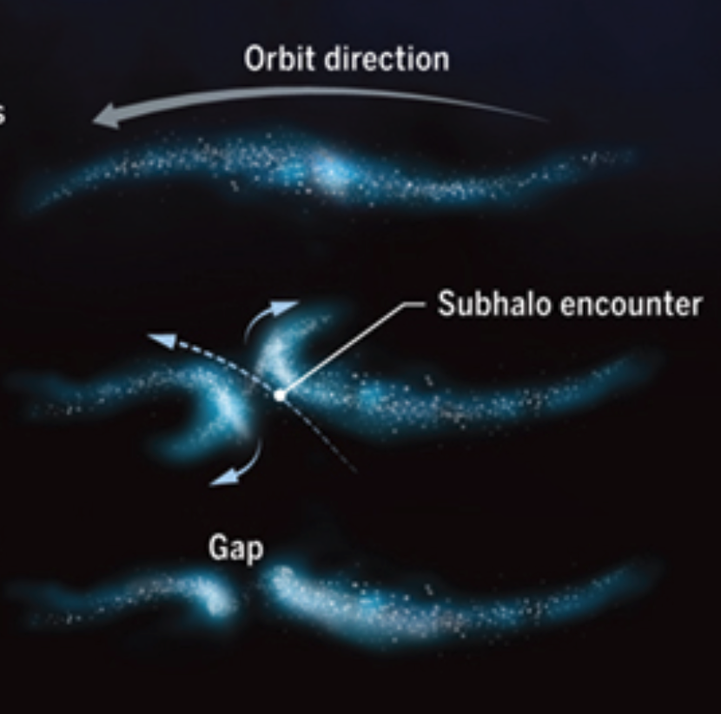
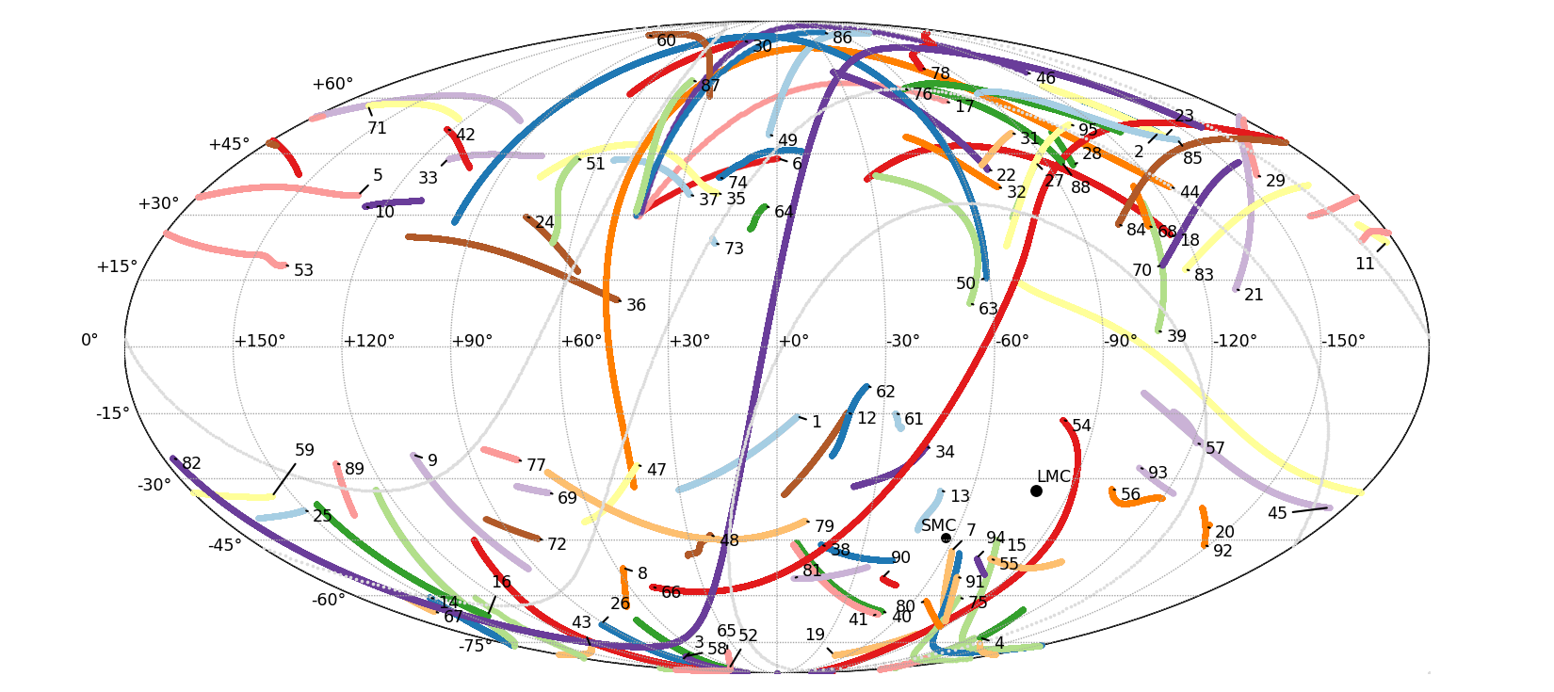

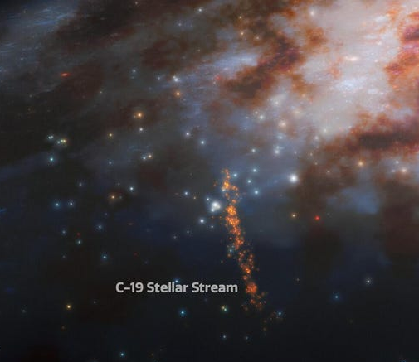
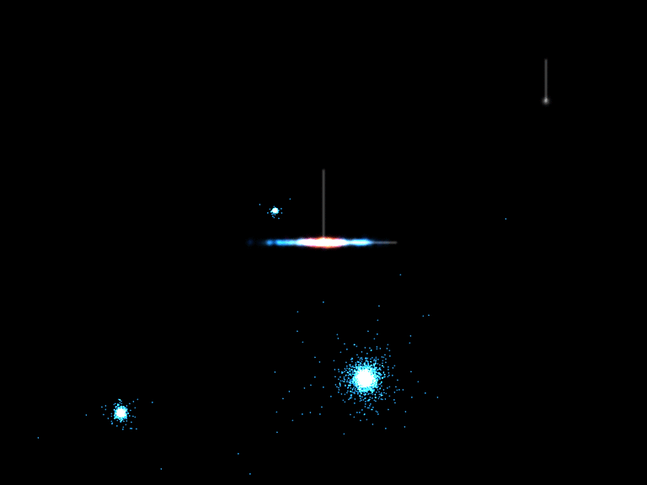
WHY ARE STREAMS IMPORTANT?
Mateu+22
C.Bickel
Martin+22
Benjamin A. Willett
viswanathan@astro.rug.nl

Slide 4
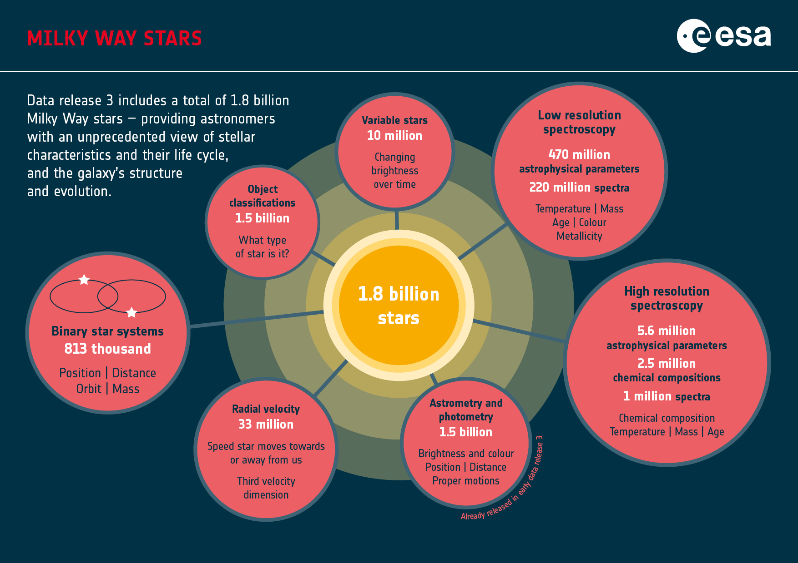
viswanathan@astro.rug.nl

Slide 5
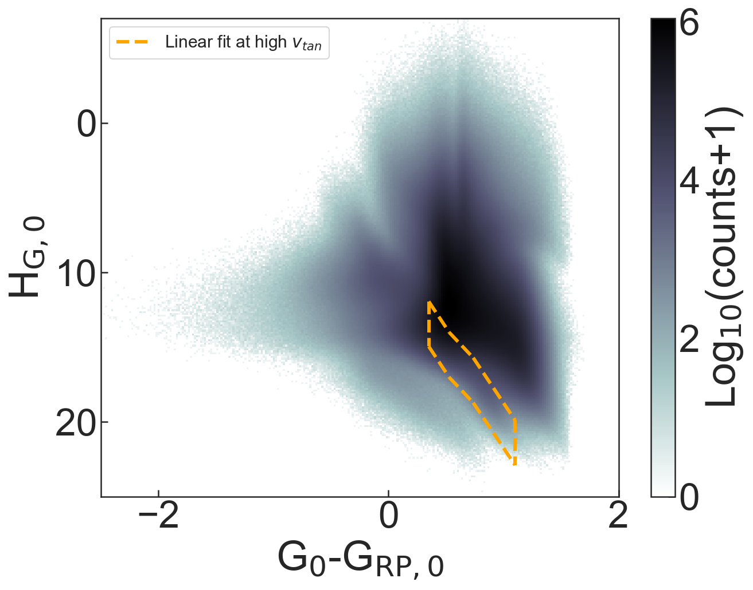
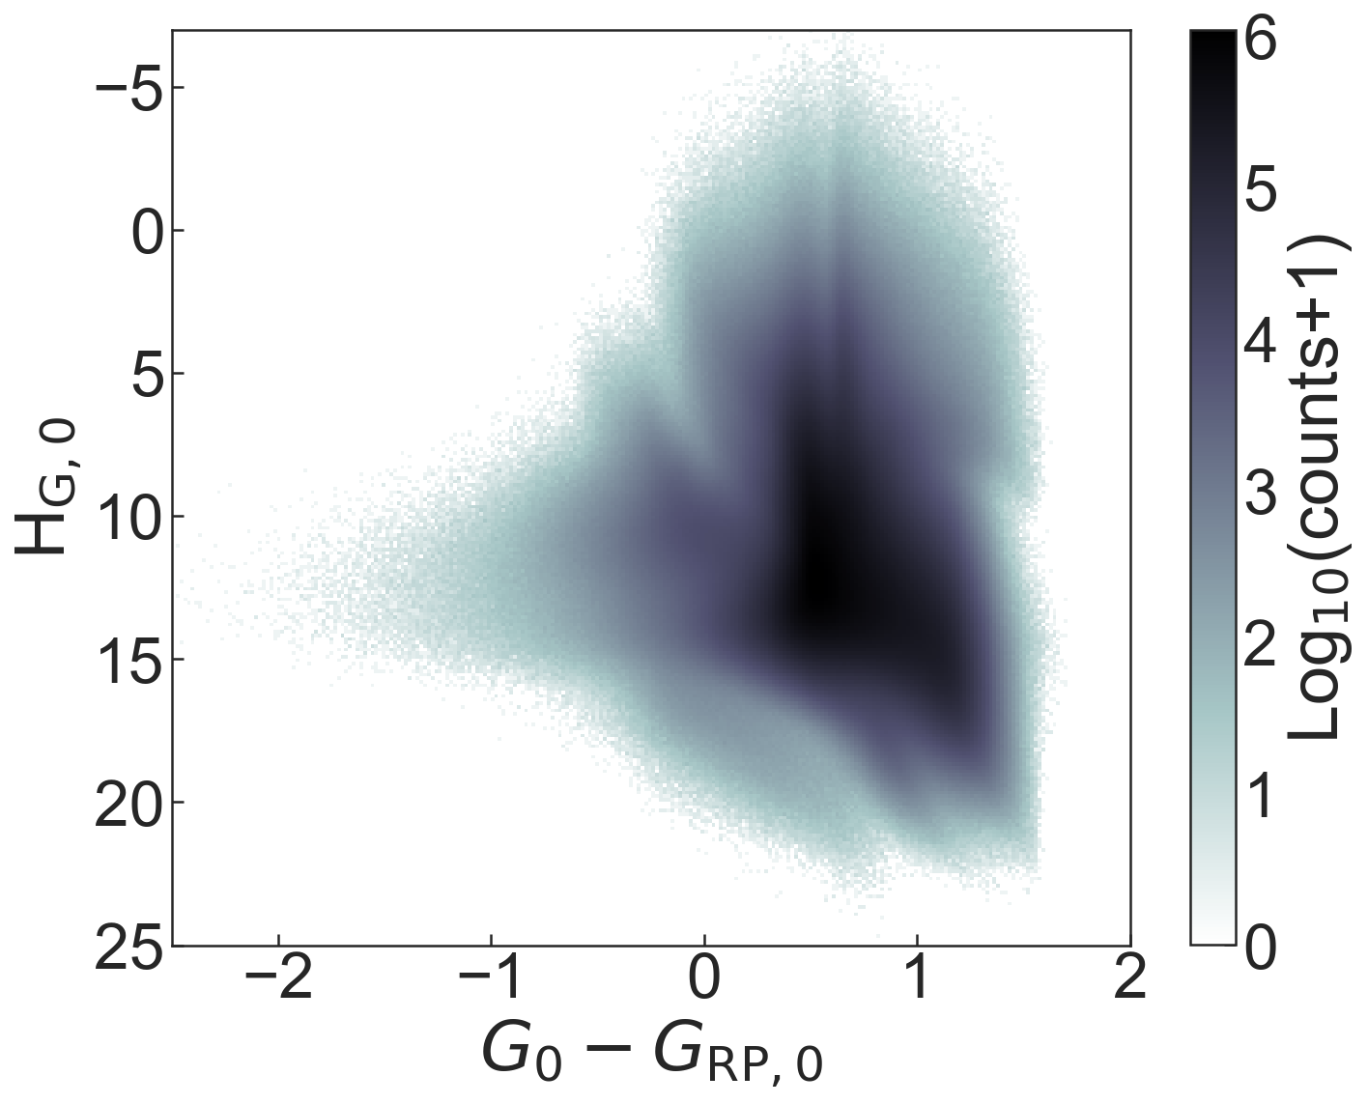
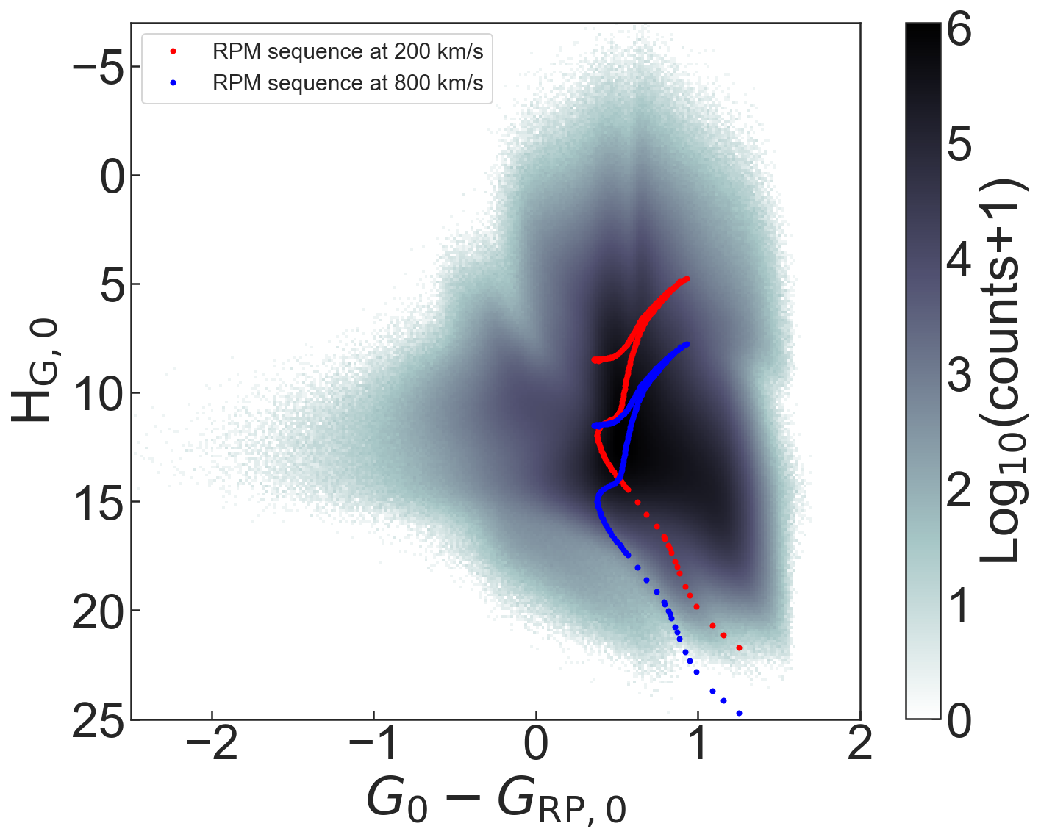
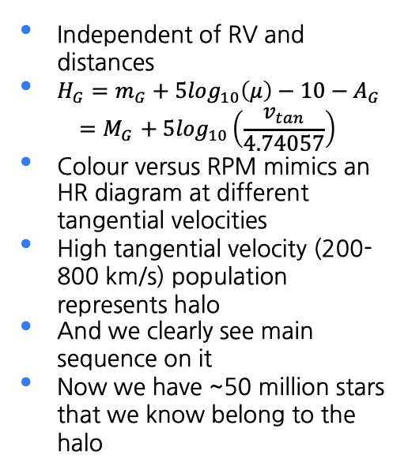
REDUCED PROPER MOTION
Independent of RV and distances
$H_{G}=m_{G}+5\log_{10}\left(μ\right)−10−A_{G}$
$${=M}_{G}+ 5\log_{10}\left(\frac{v_{tan}}{4.74057}\right)$$
Colour versus RPM mimics an HR diagram at different tangential velocities
High tangential velocity (200-800 km/s) population represents halo
And we clearly see main sequence on it
Now we have ~50 million stars that we know belong to the halo
viswanathan@astro.rug.nl

Slide 6
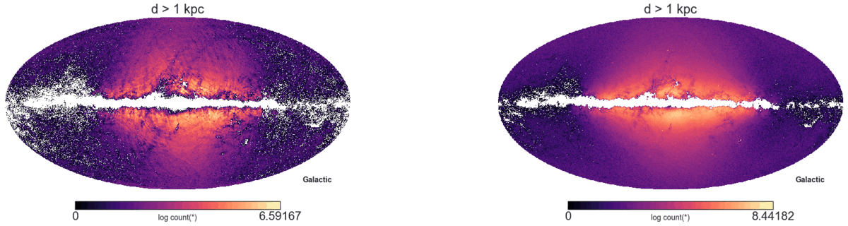
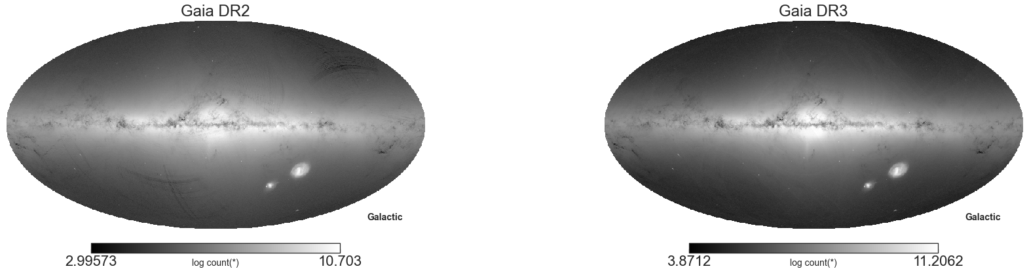
Gaia DR2 TO DR3
WHOA!
viswanathan@astro.rug.nl

Slide 7
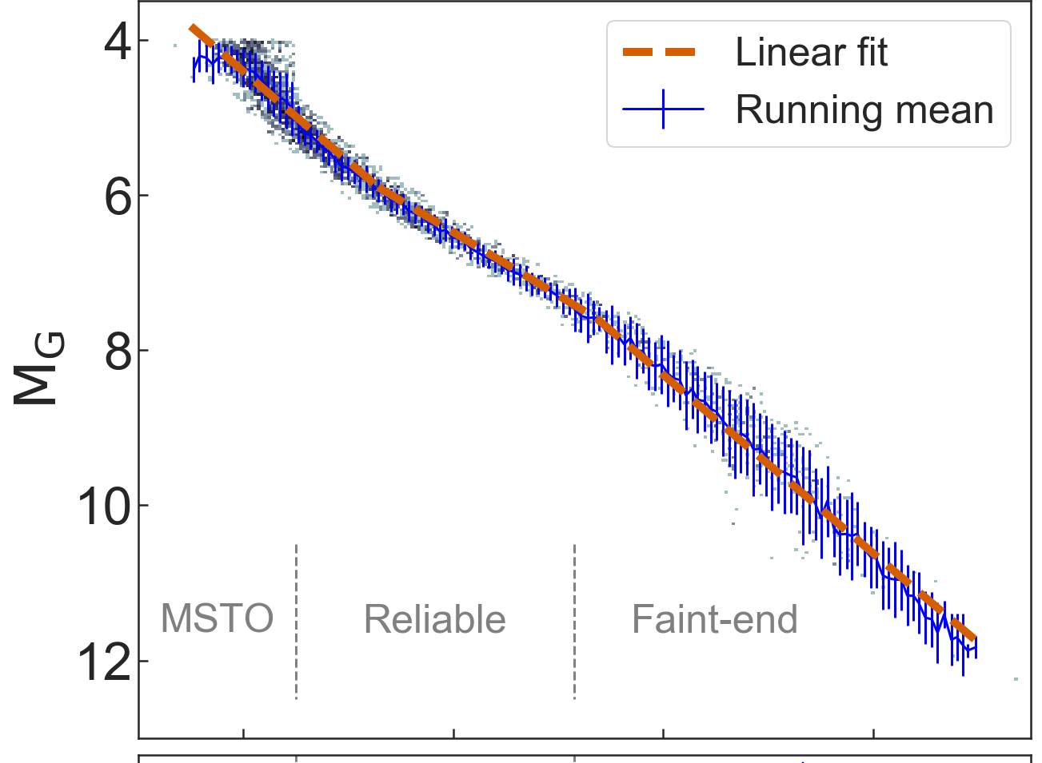
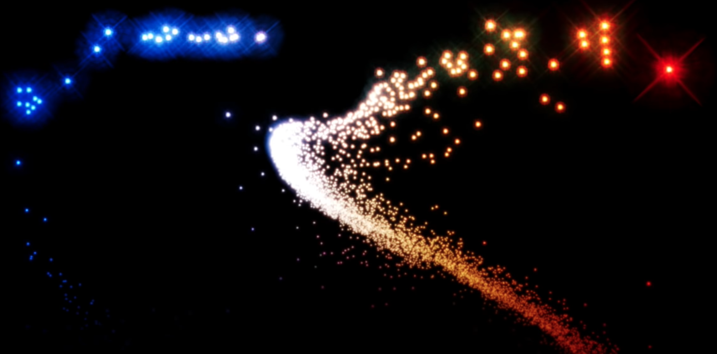
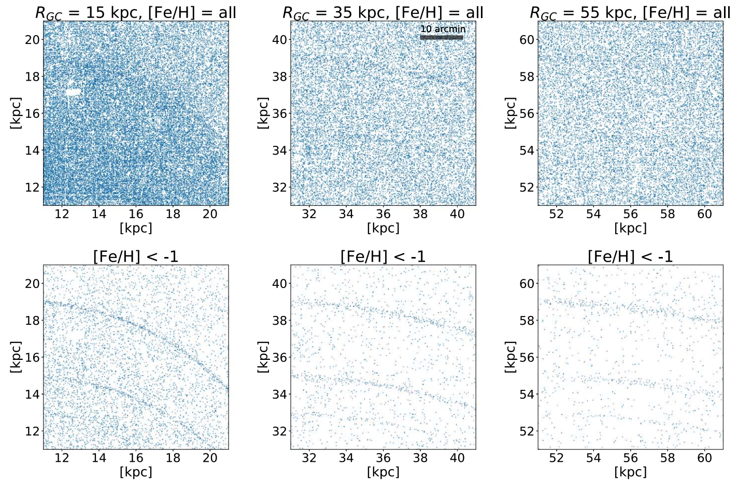
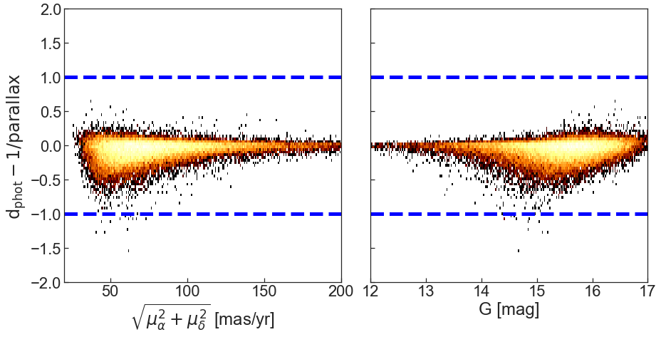
Why Main Sequence stars?
Pearson+19
Viswanathan
Numerous
Low surface brightness features
Simple distance derivation
>10² times more common than red giants.
Because they are numerous, it allows us to probe into the faint counterpart of the streams and its features
Relatively simple absolute magnitude relation as a function of colour, which can be used to calculate a photometric distance
viswanathan@astro.rug.nl

Slide 8
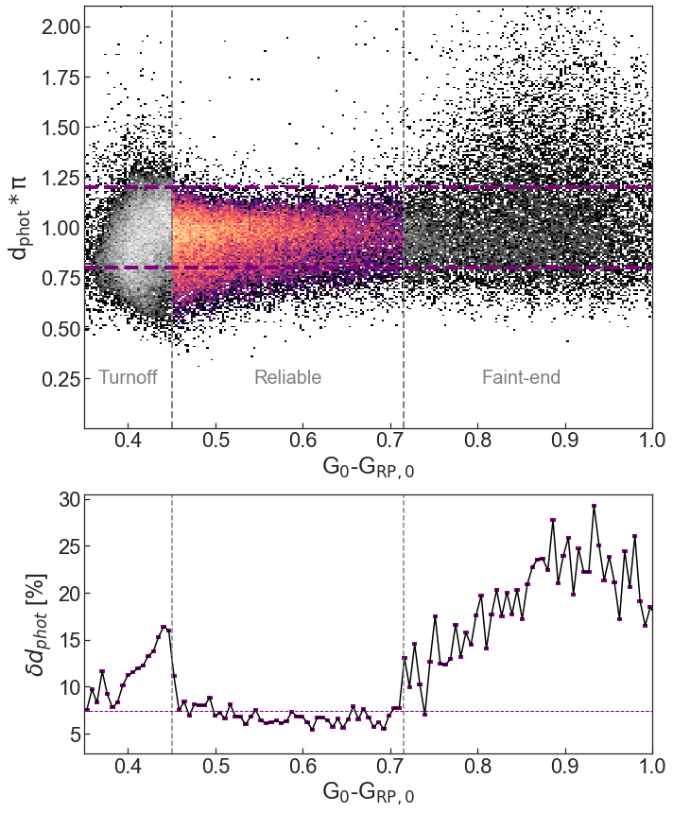
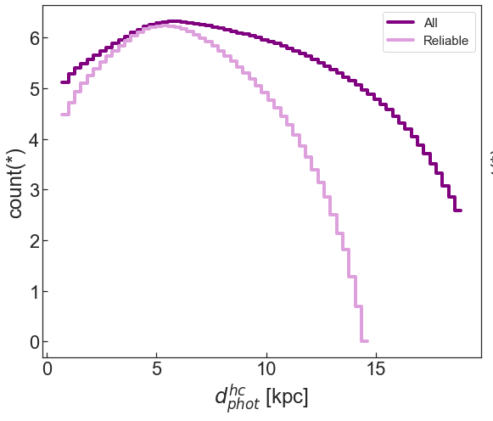

How good are these photometric distances?
Going far and beyond what would be possible using reliable Gaia parallax
Viswanathan+23
viswanathan@astro.rug.nl

Slide 9
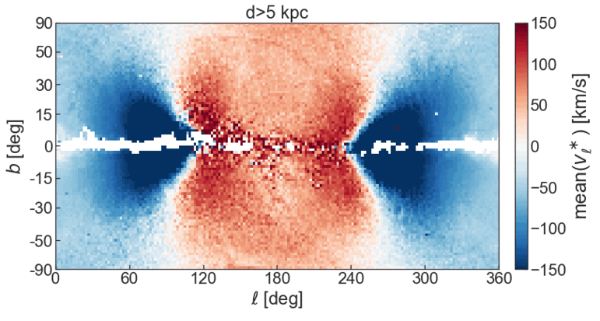
STREAMS everywhere…
viswanathan@astro.rug.nl

Slide 10
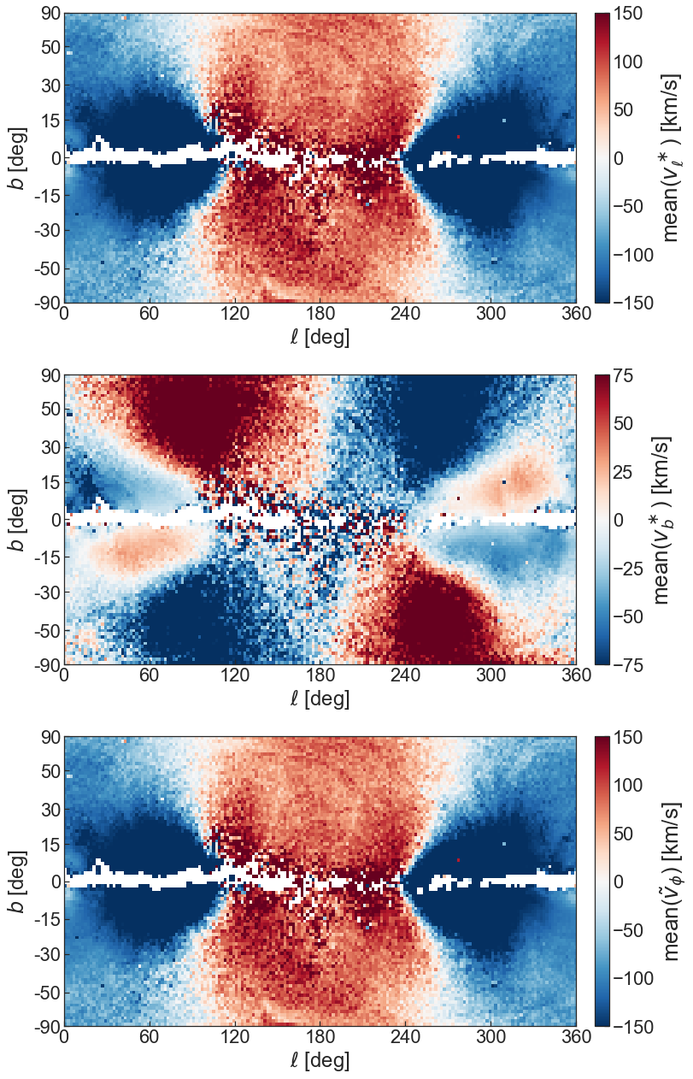
STREAMS everywhere…
Note: Pseudo space is defined by setting line-of-sight velocity component to zero
Viswanathan+23
viswanathan@astro.rug.nl

Slide 11
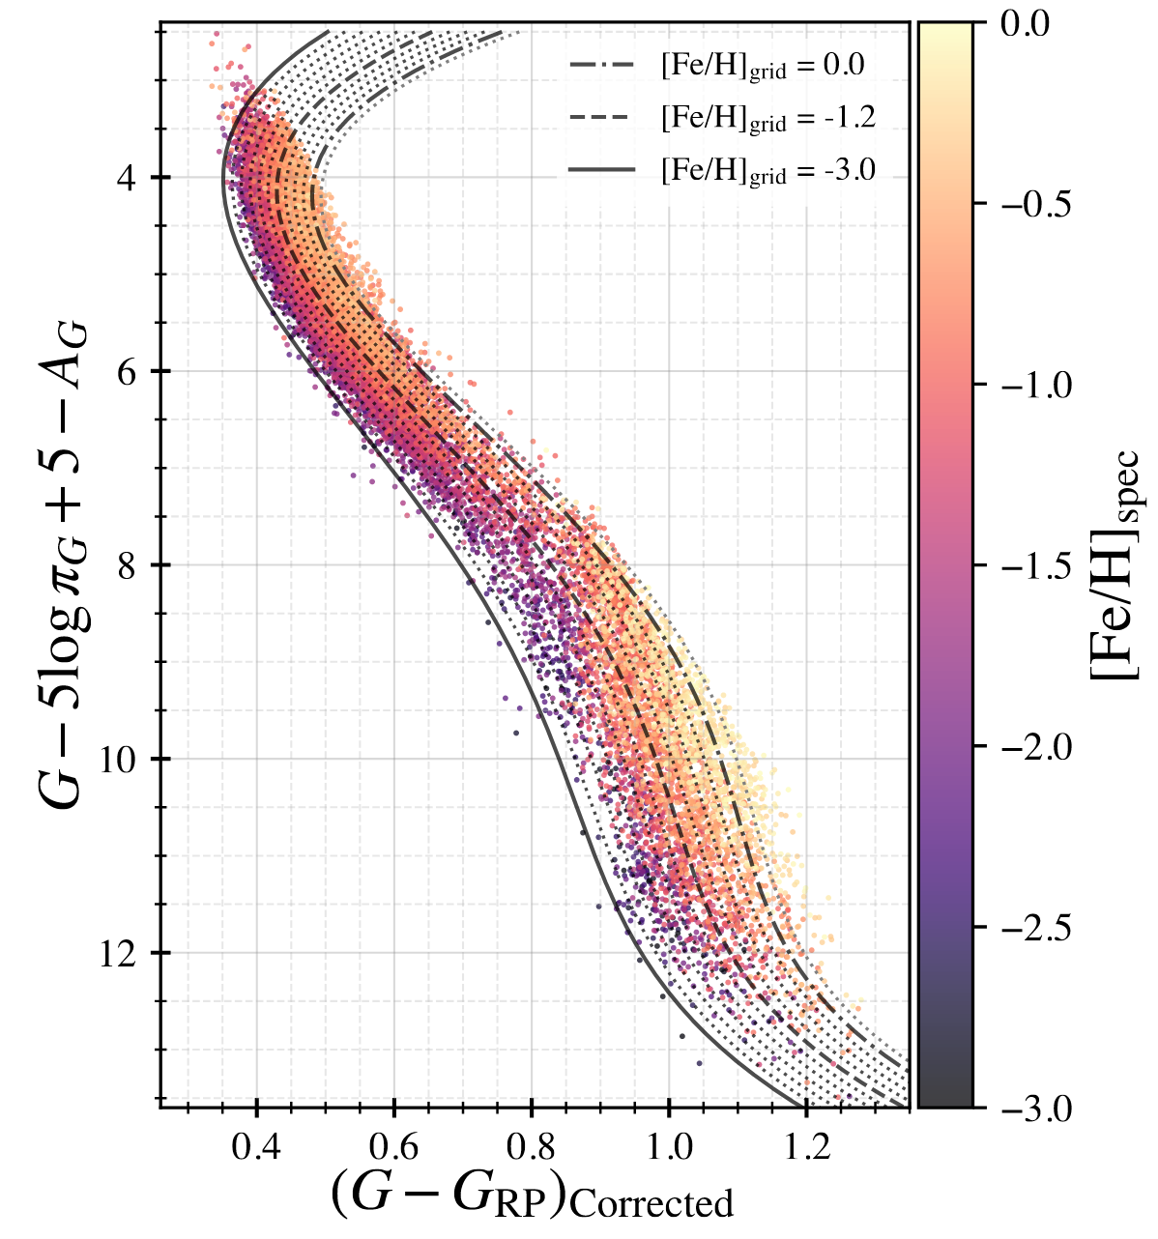
Stream selection + metallicity-dependent distances
Streams selected using position and proper motion
Contamination removed by fitting proper motion trend
Refine distances using the metallicities of the structures
Empirical isochrones from Kim & Lepine 21
viswanathan@astro.rug.nl

Slide 12
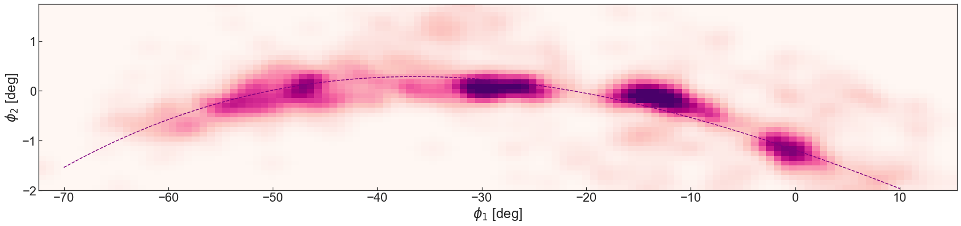
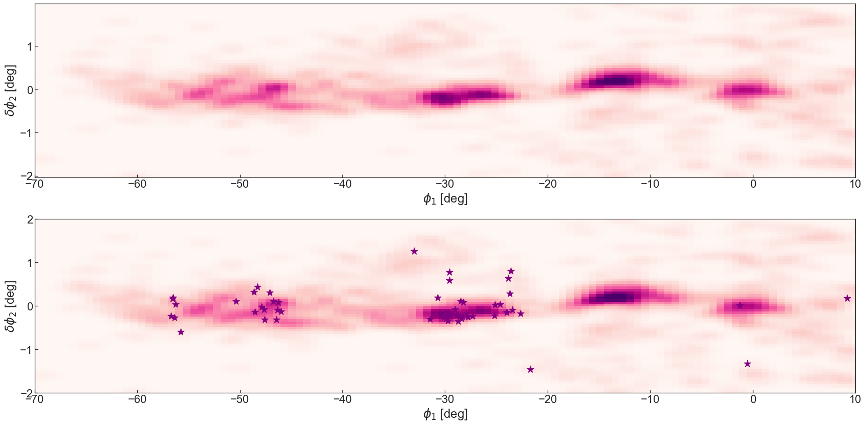
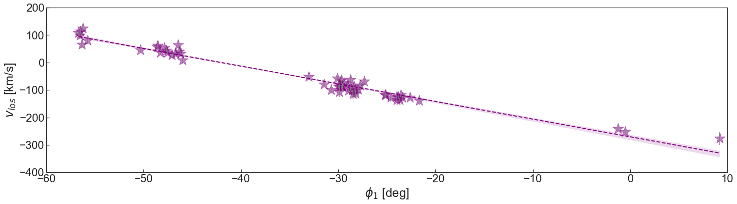
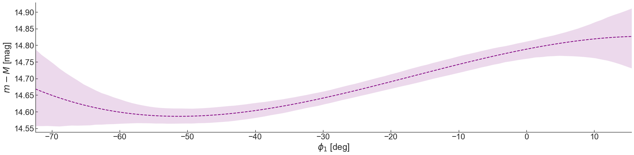
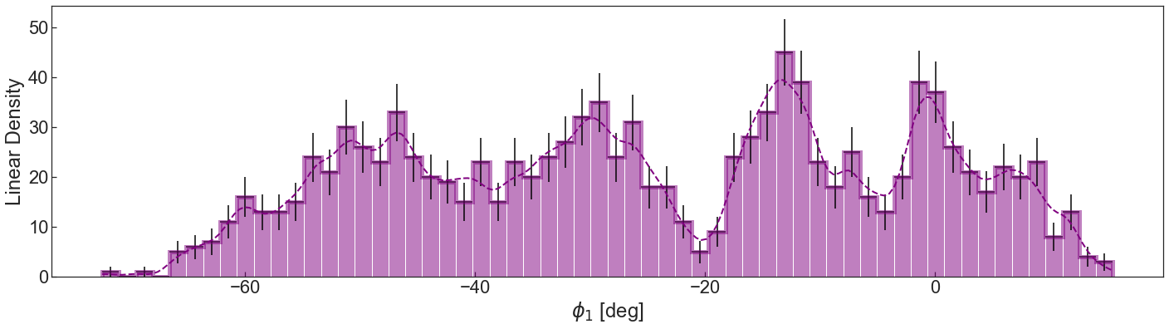
GD-1 Stream
Spur
Blob
Kink? Progenitor
Very distant RV member
GD-1’s progenitor location as modelled in Webb & Bovy., 2019
viswanathan@astro.rug.nl

Slide 13
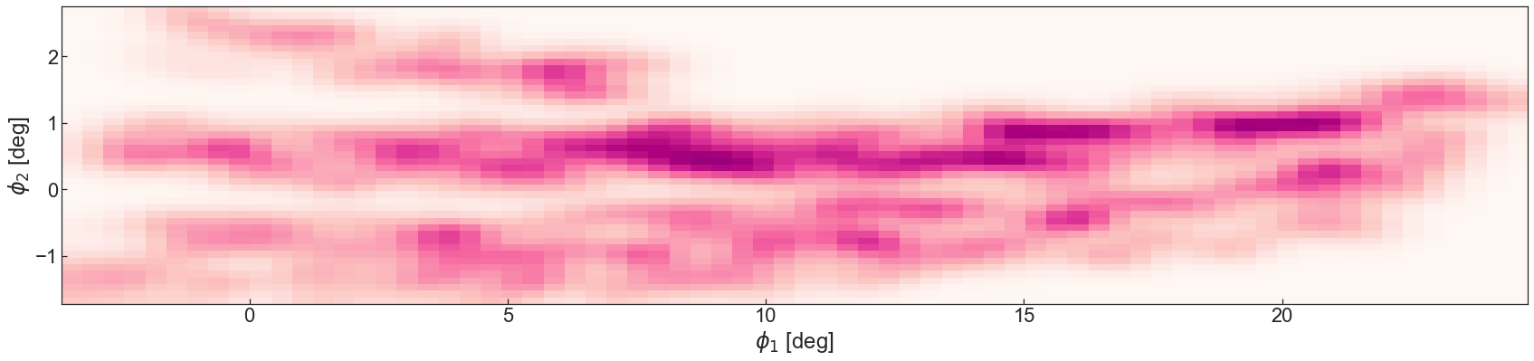
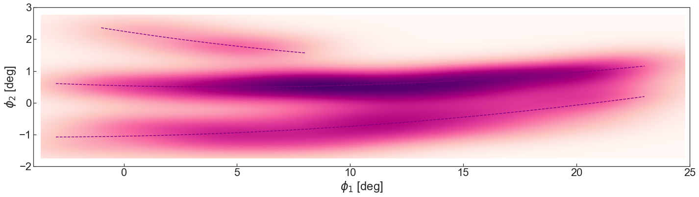
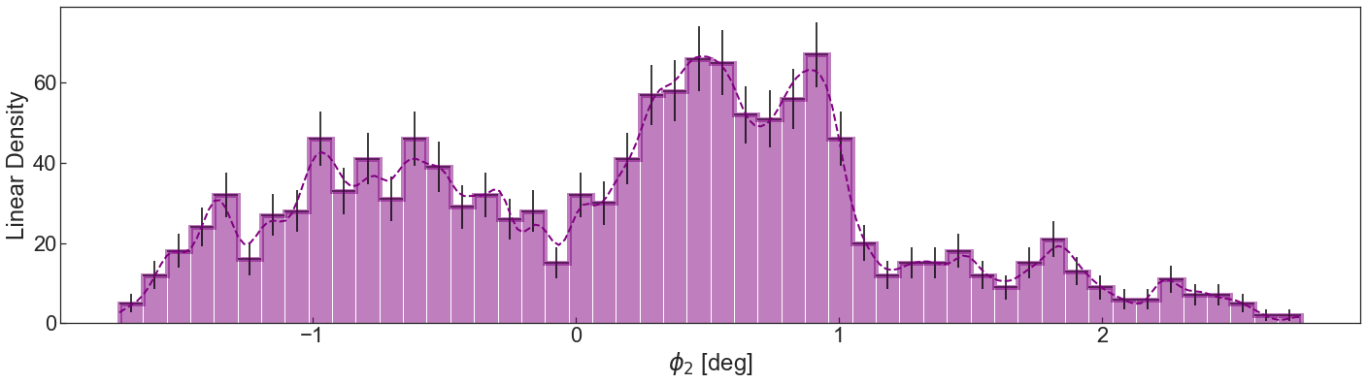
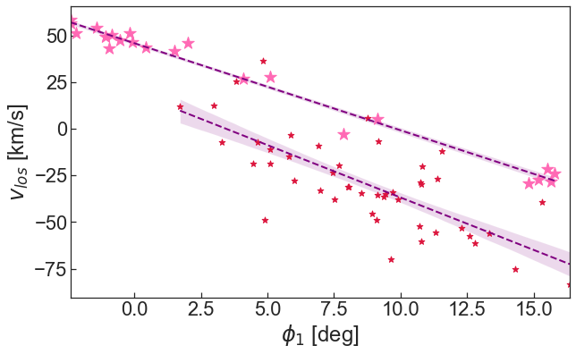
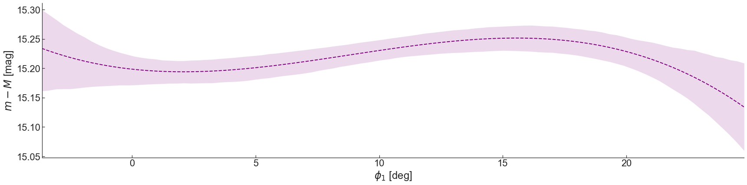
JHELUM Stream
Tertiary spur feature
Disturbance/kink
Primary narrow component
Secondary broad component
Using Locally Aligned Ant Technique (LAAT Algorithm) iteratively
Viswanathan+23, Woudenberg & Koop+22, Awad, (incl) Viswanathan+, in prep
viswanathan@astro.rug.nl

Slide 14
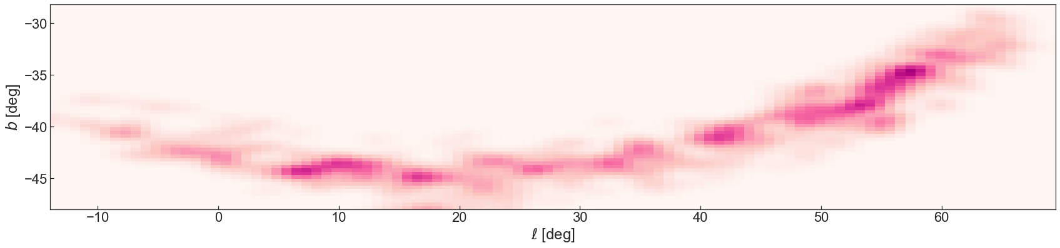
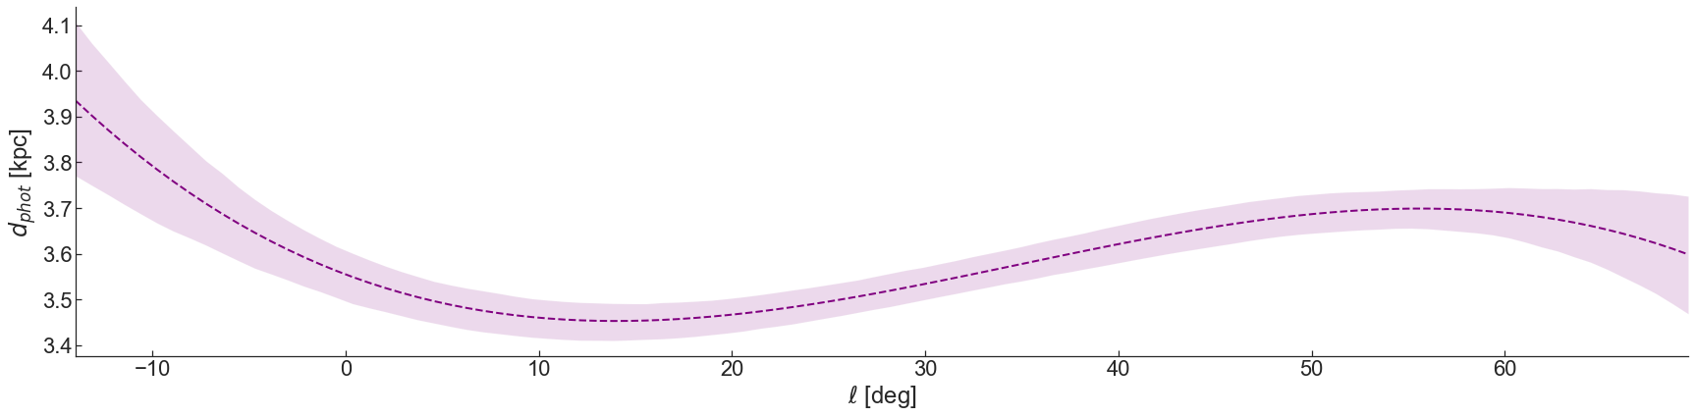
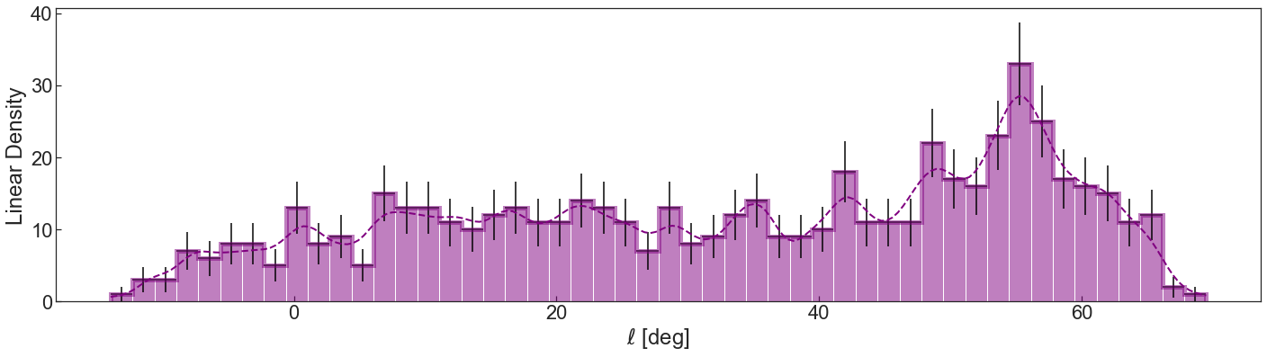
Phlegethon Stream
Density break
Anna Esselink, BSc thesis
viswanathan@astro.rug.nl

Slide 15
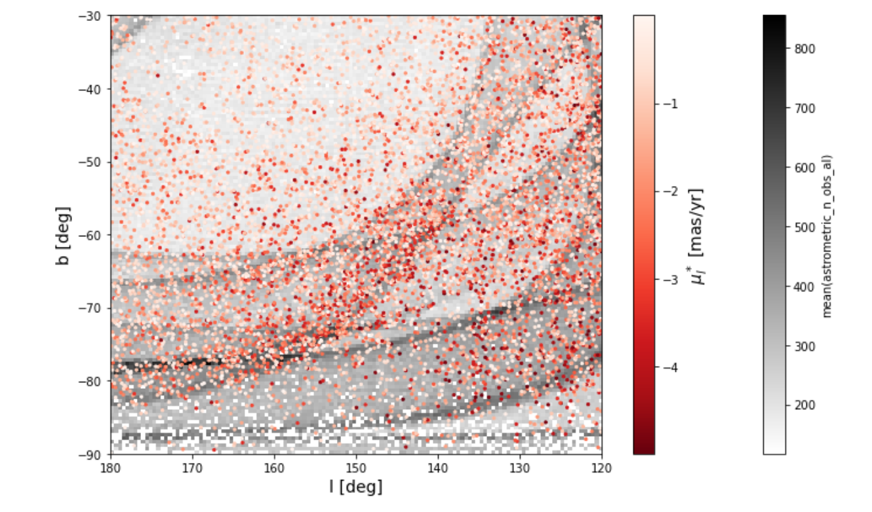
Caveats of the sample
We see part of Sagittarius (high proper motion tail) from the sub-giant branch at a specific part of the sky
Gaia scanning law at it’s limiting magnitude
Kinematic selection bias towards high PM stars
Unreliable distances at MSTO
Viswanathan+23, Anna Esselink BSc thesis
viswanathan@astro.rug.nl

Slide 16
SUMMARY
HALO SELECTION
MEAN VELOCITIES
RESOLVES GAPS AND KINKS
Out to Gaia’s faint limit with reliable distances
Allows selection of stream member candidates
Allows us to trace low surface brightness counterparts
Spectroscopic follow-up (eg., WEAVE) will yield unprecedented views of Galactic history and dynamics
METALLICITIES
HOT THICK DISC
STUDY METAL POOR MILKY WAY
Tracing the Milky Way back to its metal weak era
How hot thick disc contributes to the halo above and below the plane at different scale heights
Subsample crossmatched with Pristine survey (~1M stars). Derives metallicity dependent distances
Viswanathan+, in prep
viswanathan@astro.rug.nl

Slide 17
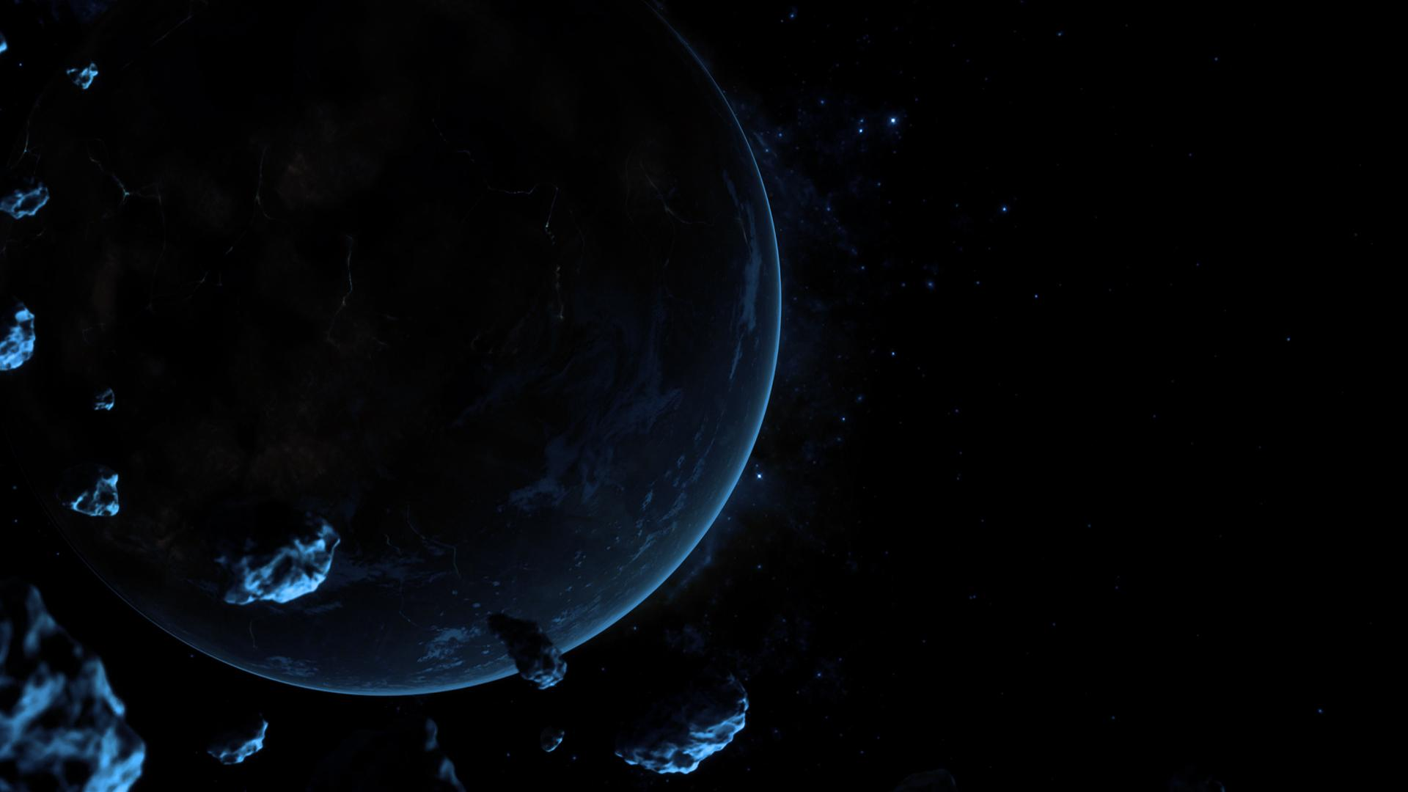

THANK YOU!
RPM sample | Max. distance | Typical distance uncertainty | Streams data released for
47 Million halo stars | 21 kpc | 7% | GD-1, Jhelum
Catalogue available at CDS: cat/J/MNRAS/521/2087
Codes at GitHub: astroakshara/RPM-Catalogue-Gaia-DR3
astroakshara
viswanathan@astro.rug.nl

